Slide 1
Chapter 4 React Setup
Koustav Mukherjee

Slide 2
Content
Introduction
React setup
Install packagers
App.js
Connect backend using api.js
Login.js
Registraion.js
Router.js
Home.js
Use login and registration.

Slide 3
Introduction
React is a JavaScript library for building user interfaces.
React is used to build single-page applications.
React allows us to create reusable UI components.

Slide 4
React Setup
First thing before starting our setup , we have to organize our codes so that we can have parallel services running in the frontend . Create one folder and call it backend ,move all the codes that we do in previous tutorial and put it in this folder (backend).
For run the two different server split the terminal for run two server.

Slide 5
React Setup
Steps to run the server from these two different directories .
Step 1 - If we want to start server from backend folder , the command we use to switch from main directory to backend folder is cd backend With the help of this command , we will switch to the folder backend .
Step 2 – After switch to backend folder we will now to run the server , npm start
Step 3 – If we want to come back to main folder from backend folder , cd..

Slide 6
React Setup
So now ,after organize the codes we will do setup of react application.
npx i create-react-app frontend
Wait few minutes for creating the app
So after setup we will cleanup an unused code that we have .

Slide 7
React packages
There is library that is called reactstrap , which is the version of bootstrap . On terminal , we are going to install this library .
npm install --save bootstrap
After finishing , let’s install reactstarp library .
npm install - -save reactstrap
To import bootstarp CSS in src/index.js file ,
import‘bootstrap/dist/css/bootstrap.min.css’
Start the server once again and remember that you need to be inside the frontend folder .
For start the server use npm start.

Slide 8
React Setup
After that , we will move to App.js file , and start writing some code
Src > app.js
import { Container } from 'reactstrap'
return (
<Container>
<h1>Sport's App</h1>
</Container>
);

Slide 9
React setup
First thing we will do , create new folder in src and name it as “pages ”. in this folder we have different pages like login page ,registration page ,dashboard page and home etc . Inside this folder we will create another initial folder “Login”. As we do not have anything in this folder , we will create new file “login.js” .
Flowing this path :- Pages > login > login.js

Slide 10
React set up
In login.js we write the code
import React from 'react'
const Login =()=>{
return (
<div>
<h1>login</h1>
</div>
)
}
export default Login;

Slide 11
React Setup
React has a library they’re kind of very helpful us in navigating around the things , that is called react-router-dom . Stop the server and for installing
npm i react-router-dom
In source folder , we made new file called “router.js” .

Slide 12
React Setup (Router.js)
import React from 'react'
import { BrowserRouter, Routes,Route } from 'react-router-dom';
import Login from './pages/Login/'
export class router extends Component {
render() {
return (
<BrowserRouter>
<Routes>
<Route path="/login" element={<Login />} />
</Routes >
</BrowserRouter>
);
}

Slide 13
React Setup(add code app.js)
Now , import this file in “App.js” file
import Routes from './routes';
return (
<Container>
<h1>Sport's App</h1>
<Routes/>
</Container>
);

Slide 14
React Setup( Api setup )
Next thing is the configuration that allow us to use another library to fetch the data from API . Stop the server once again.
For backend connectivity we use Axios. It is a Javascript library used to make HTTP requests from node. js or XMLHttpRequests from the browser and it supports the Promise API that is native to JS ES6.
For install Axios we use following command:- npm i axios.
After istall Axios we move to in source folder , create another folder “services” . Inside this folder we’re going to create an new file and will be called “api.js” .
Flowing the path Src >Services > api.js

Slide 15
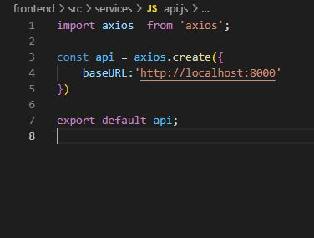
React Setup( Axios.js )

Slide 16
React Setup( Axios.js )
After use axios we are connect to backend and use the create method we are go the port:8000 and process the data from backend part.

Slide 17
React Setup(Login.js)
After that go to in Src folder and go to login folder and open the login.js file
Write the login code that are use for create a login page .

Slide 18
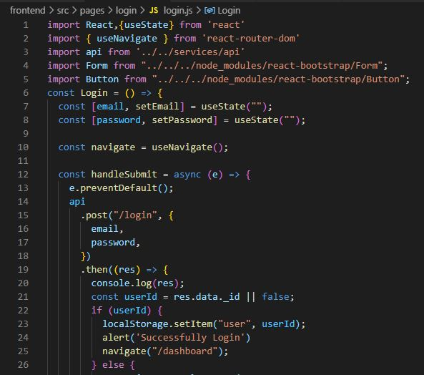
Login.js

Slide 19
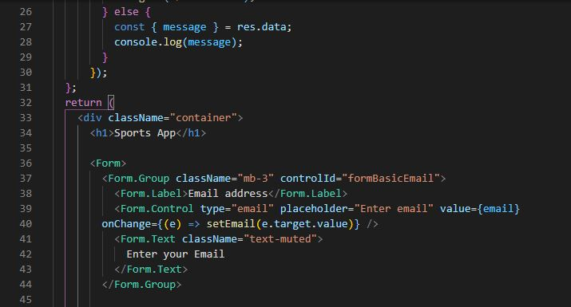
Login.js

Slide 20
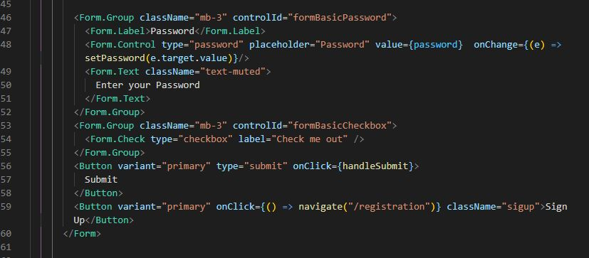
Login.js

Slide 21
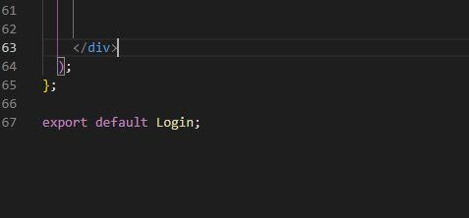
Login.js

Slide 22
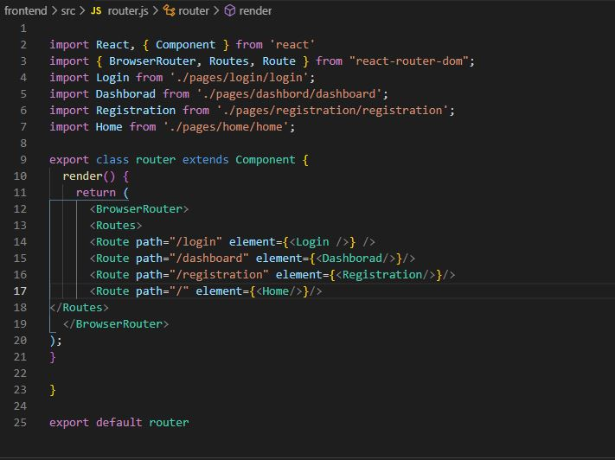
Add login path into router.js

Slide 23
Log-in functionality
In login.js file we are use Hooks. Hooks is a spacel function that lets you where you are hooks into. useState is a hooks that add react state to a functional component.
After that we are use handelSubmit and onChange funcanality that onChange use for In input tag , we are basically pass another property . And use the handelSubmit property we are submit the data value .
After that it Use API to send value to the server and check against the server .

Slide 24
Check the login
Now ,it’s time to run code by server and test it . So , we will follow the following steps –
Step 1 - Open Insomnia or any other API that you are using previously . Here I am using Insomnia . From getUserById request, I copy EmailID and I hope you remember the password that you write while creating new user . So go on frontend UI and paste email ID, type password and click on Submit button .
Step 2 - After Clicking on Submit button , you will redirect on Dashboard page . If you type wrong mailId and password it will give you error message and you can see Network (Ctrl + Shift + I ).

Slide 25
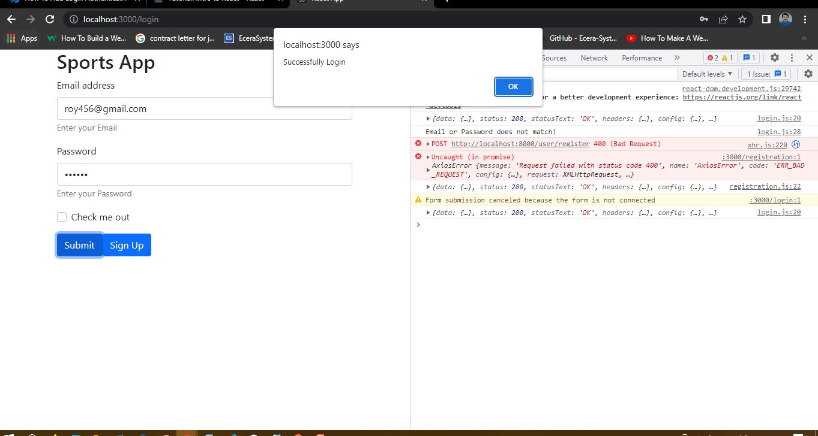
Success of login

Slide 26
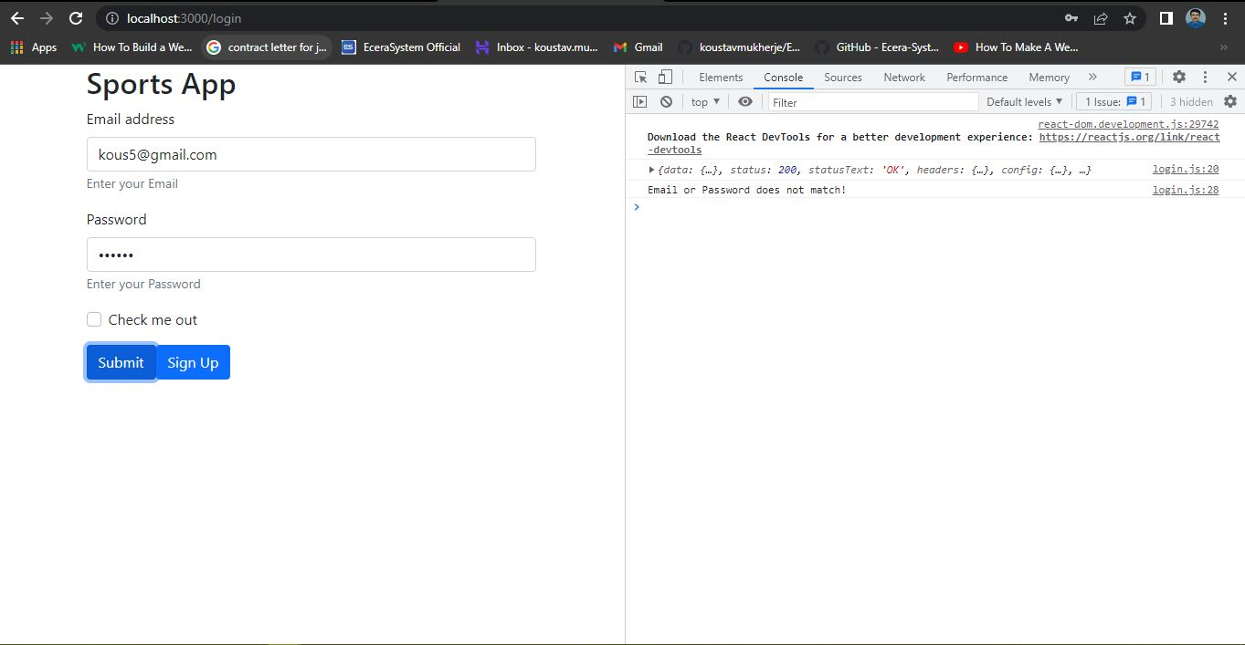
Unsuccessful login wrong password

Slide 27
Register.js
After the completing the login page we are create the registration page for registration a user .
for registration go to Src folder and then go pages folder into the pages folder we are create an folder registration after the create registration folder create registration.js file into the registration folder.
Src > pages > registration > registration.js

Slide 28
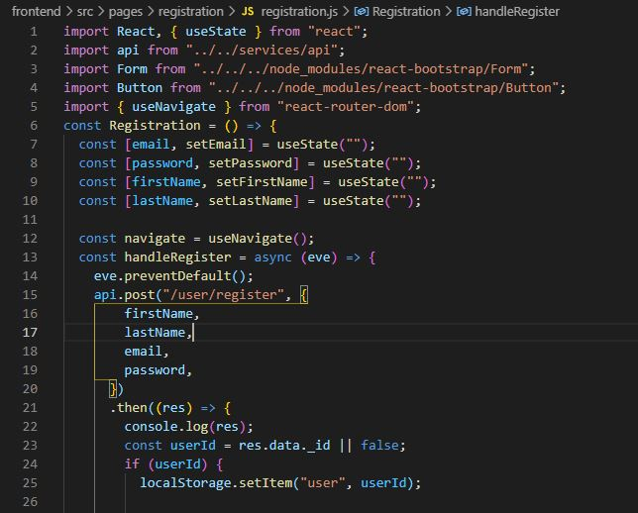
Registration.js

Slide 29
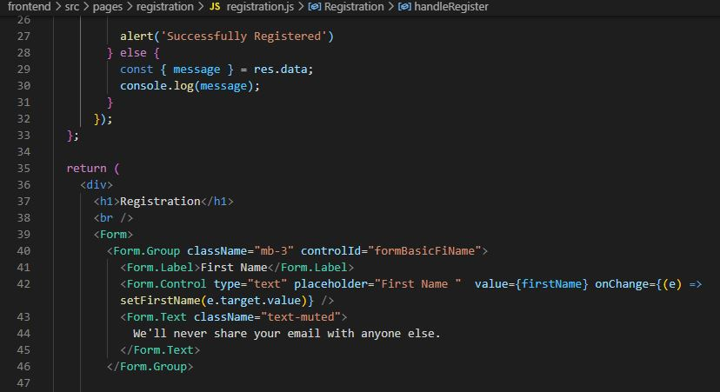
Registration.js

Slide 30
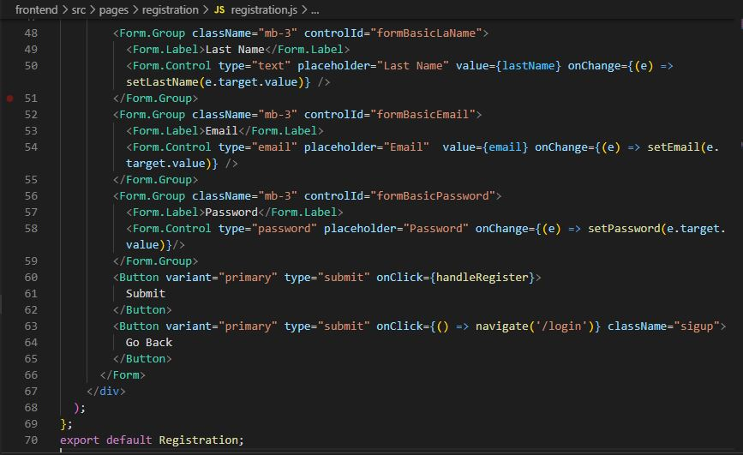
Registration.js

Slide 31
Add registration path into router.js

Slide 32
Check the Registration page
After all this , we will test the register page is working or not . So on URL path we type “localhost:3000/registration” .
After the successful registration we go to login page and after login its shows login successful and show the dashboard.

Slide 33
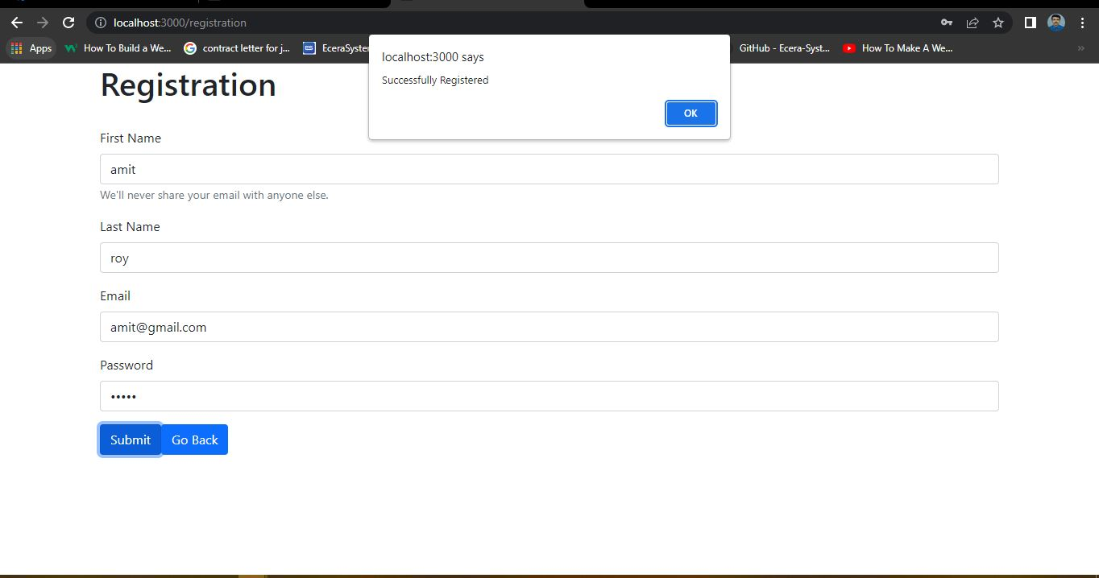
Registration a user successful

Slide 34
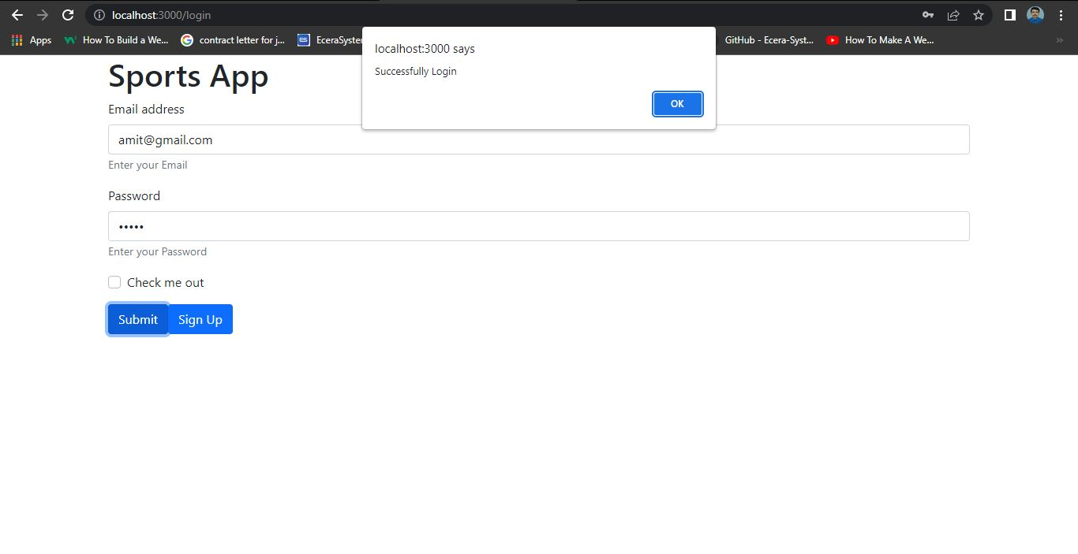
After registration login

Slide 35
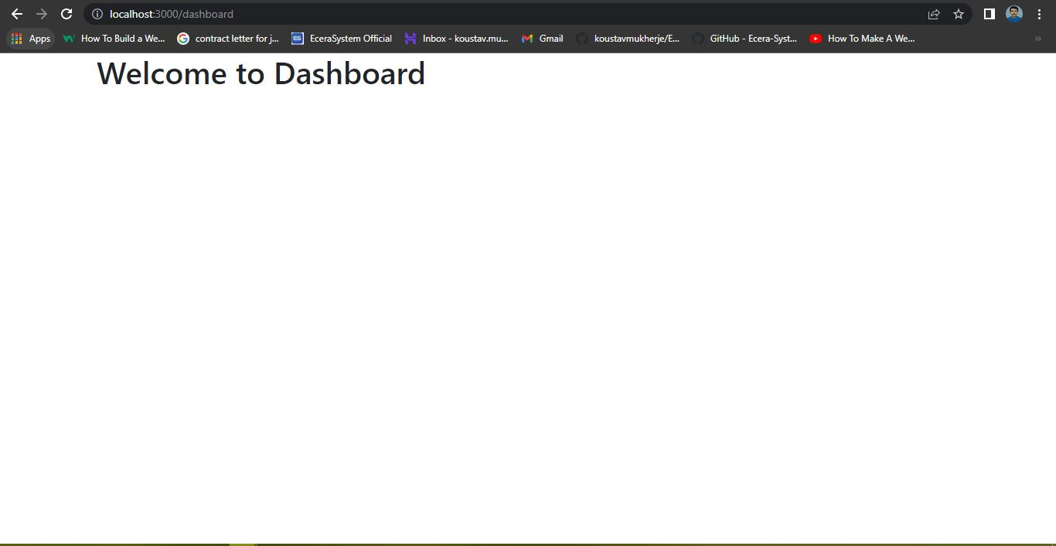
After successful login dashboard

Slide 36
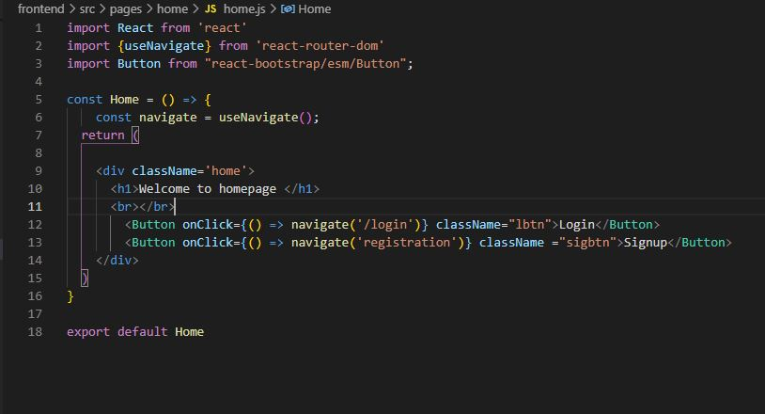
Home .js

Slide 37
Home.js
In home.js we are use navigate for switch the login and registration .
And create a homepage for sign-in and register that can routes directly from this two pages.

Slide 38
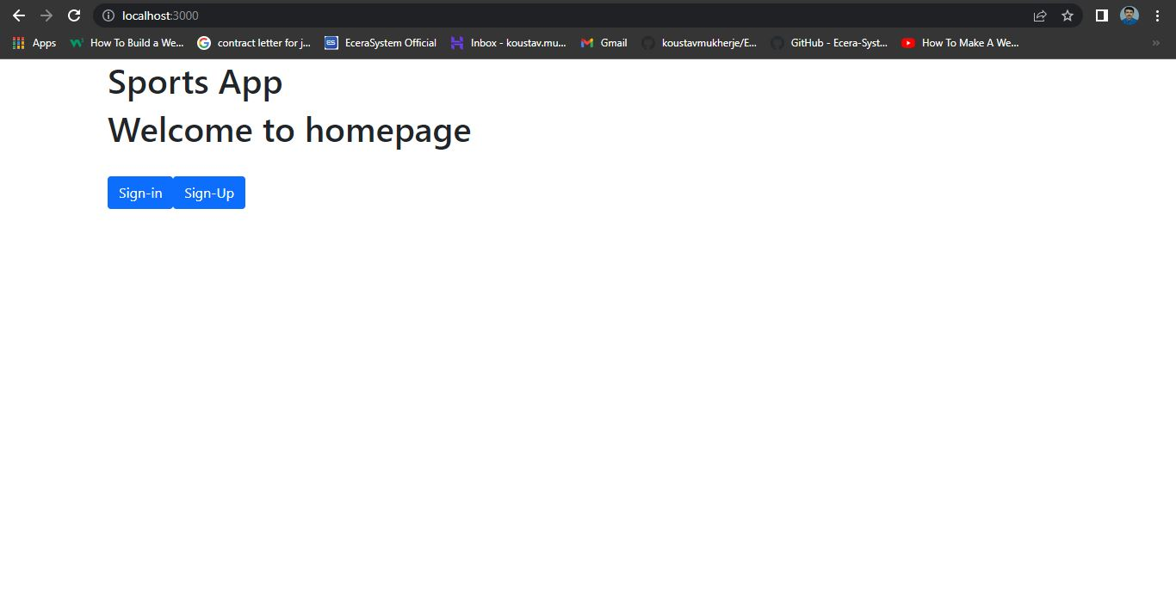
Home page

Slide 39
Thank You

